Slide 1

KS2 English Workshop for Parents
Baxenden St John’s
16th January 2020

Slide 2
Tonight’s Aims…
To review the National Curriculum expectations for English at KS2
To share the English intent at Baxenden St John’s
To explore what we currently do in school to support your child’s progress in English
To provide information on how you can help at home

Slide 3
The National Curriculum
The national curriculum for English aims to ensure that all pupils:
read easily, fluently and with good understanding
develop the habit of reading widely and often, for both pleasure and information
acquire a wide vocabulary, an understanding of grammar and knowledge of linguistic conventions for reading, writing and spoken language
appreciate our rich and varied literary heritage
write clearly, accurately and coherently, adapting their language and style in and for a range of contexts, purposes and audiences
use discussion in order to learn; they should be able to elaborate and explain clearly their understanding and ideas
are competent in the arts of speaking and listening, making formal presentations, demonstrating to others and participating in debate.

Slide 4
Intent at Baxenden
At Baxenden St John’s, we strive for children to be ‘Primary Literate Pupils’, able to read, write and speak fluently and confidently in order to express themselves as fully as members of society. Our children develop the powers of imagination, inventiveness and critical awareness, so that they can achieve a strong command of the English language and how to both manipulate and enjoy it. We provide a high-quality English curriculum which cultivates a passion and enthusiasm for reading, writing and exploring and experimenting with vocabulary and a range of literature.

Slide 5
How is our curriculum taught?
Your children are taught various aspects of the English curriculum throughout the school week. This includes:
A daily guided reading session (20 minutes)
A daily English lesson (45-60minutes)
A daily spelling session (15 minutes)
Up to 3 handwriting sessions weekly (15 minutes)
In addition to this, they are expected to read daily at home and complete an English homework weekly.

Slide 6

Reading

Slide 7
Guided Reading
Day 1 – Close reading
Day 2 – Guided Reading
Day 3 – Follow up
Day 4 - Comprehension

Slide 8
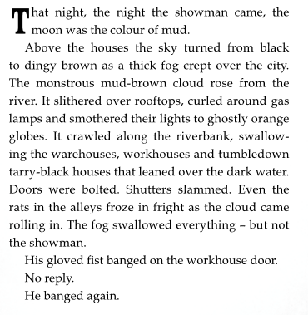

Slide 9
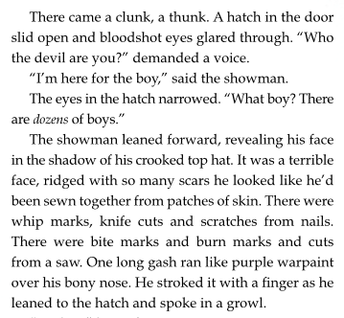

Slide 10
What impression do we get of the showman?
How is this achieved? (Focus on inferences made through the use of language)
If time allows, give the children some time in pairs/groups to discuss the mystery surrounding the boy and make predictions. Does it remind them of anything (reminds KE of the first time Voldemort meets Tom Riddle in Harry Potter.)

Slide 11
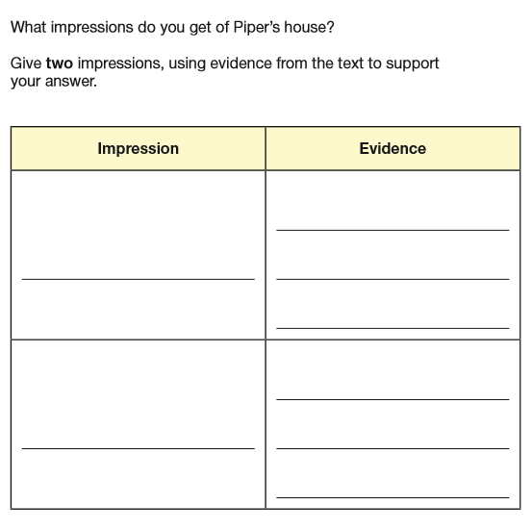
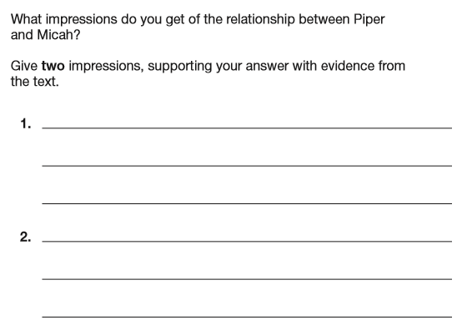
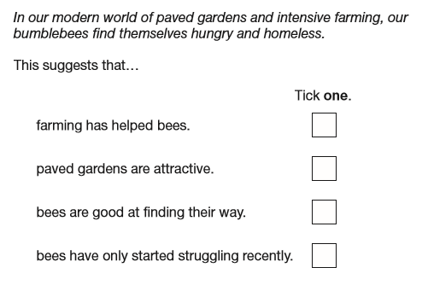
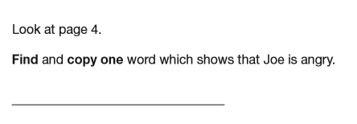
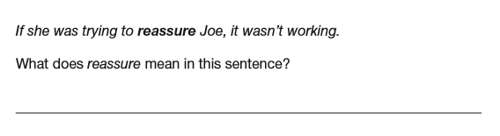

Slide 12
How can you help?
Read with your child daily and be overly enthusiastic!
Visit the library/WHSmith/Waterstones to browse and reserve new releases
You read the books too – they love reading what the adults read
Ask lots of questions whilst reading – focus heavily on vocabulary and inference (what do you think and why?)

Slide 13
Handwriting at Baxenden
For some it is purely an art form, and the neatness and accuracy of the presentation is the main focus. For others, it needs to be a functional tool which allows them to put ideas on paper, effortlessly and fast.
Handwriting is a means of communicating to others. It can be very personal, a part of our self-image and an expression of our own personality.
Handwriting might be some or all of these things.

Slide 14
Progression in Handwriting (KS2)
Year 3- form and use all 4 basic handwriting joins
- Write legibly
Year 4- as above and…
- Write with consistency in size
- Ensure that down strokes of letters are parallel and equal
Ensure that writing is sufficiently spaced
Year 5- as above and…
Write fluently with a joined style
Write at speed
Choose when it is appropriate to join or print
Year 6- as above and…
Write with increasing speed
Choose the writing implement that is best suited for a task

Slide 15
Progression
4 basic joins :
Diagonal joins to letters without ascenders
e.g ai, ar, un
Horizontal joins to letters without ascenders
e.g. ou, vi, wi
Diagonal joins to letters with ascenders
e.g. ab, ul, it
Horizontal joins to letters with ascenders
e.g. ol, wh, ot

Slide 16
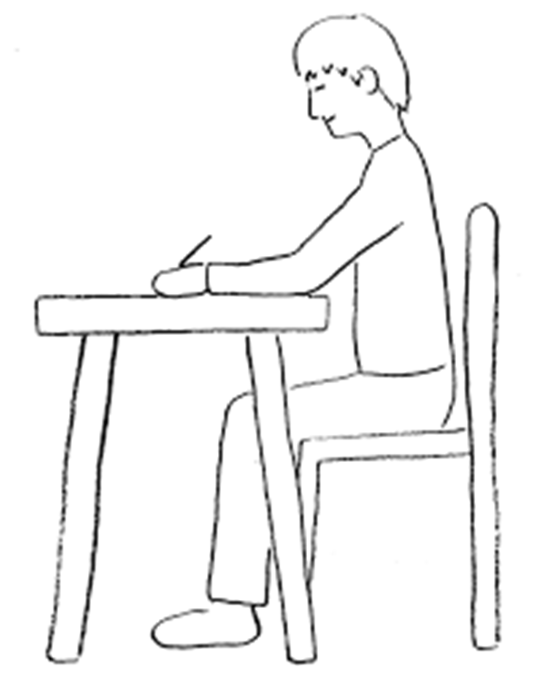
A Typical Handwriting Session
1. Posture
2. Warm up
3. Practise a particular join- Horizontal joins to letters with ascenders- wh
4. Apply the join into a word

Slide 17
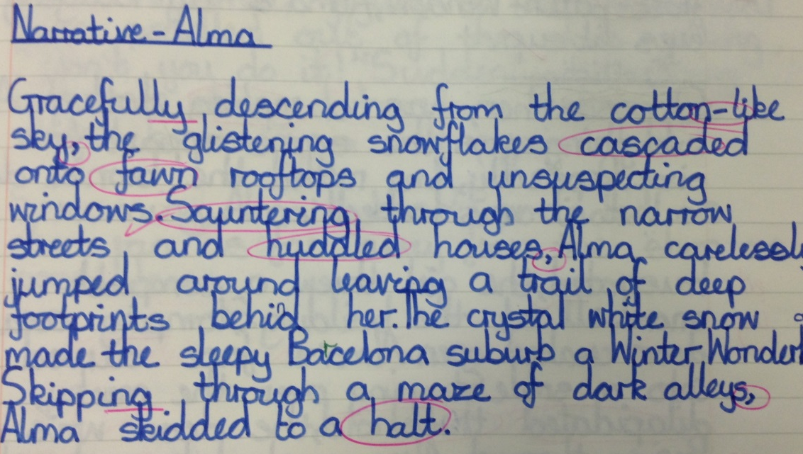
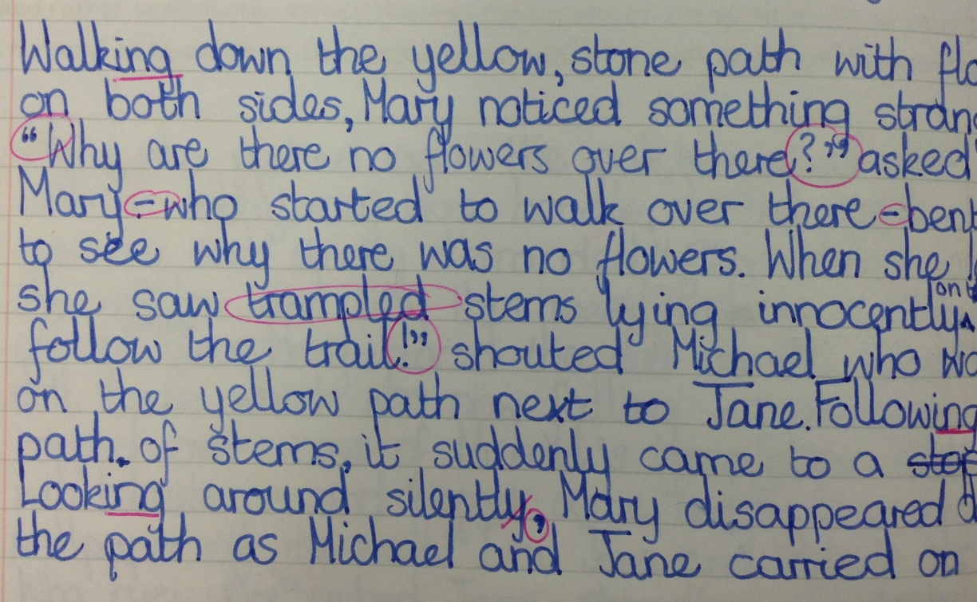
Examples

Slide 18
How can you help?
Place importance on handwriting whenever children are writing- not just in their homework
Encourage good posture when they are writing
Ensure they are using a sharp pencil or suitable pen
Most importantly, praise and promote- it will not change overnight!

Slide 19
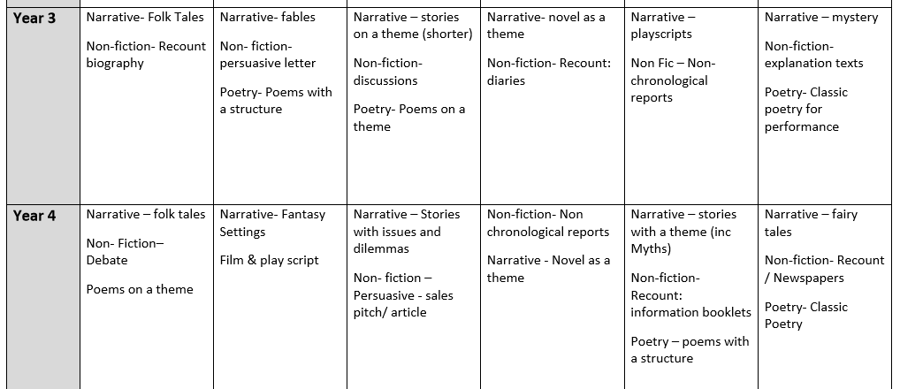
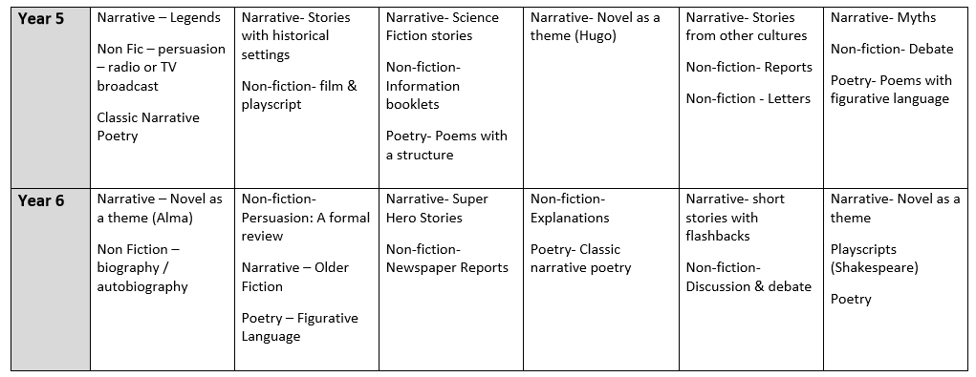
English Lessons
Our English lessons at Baxenden focus on a variety of texts and genres from fiction, non-fiction and poetry.

Slide 20
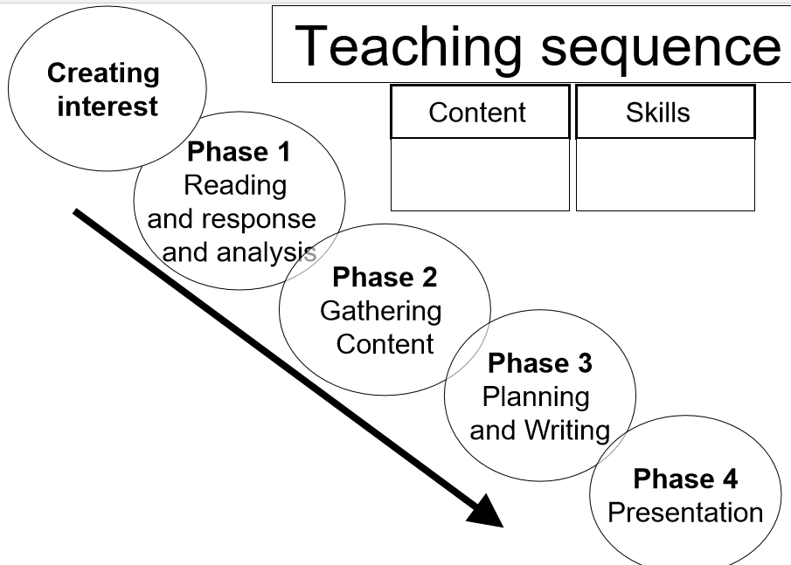

Slide 21
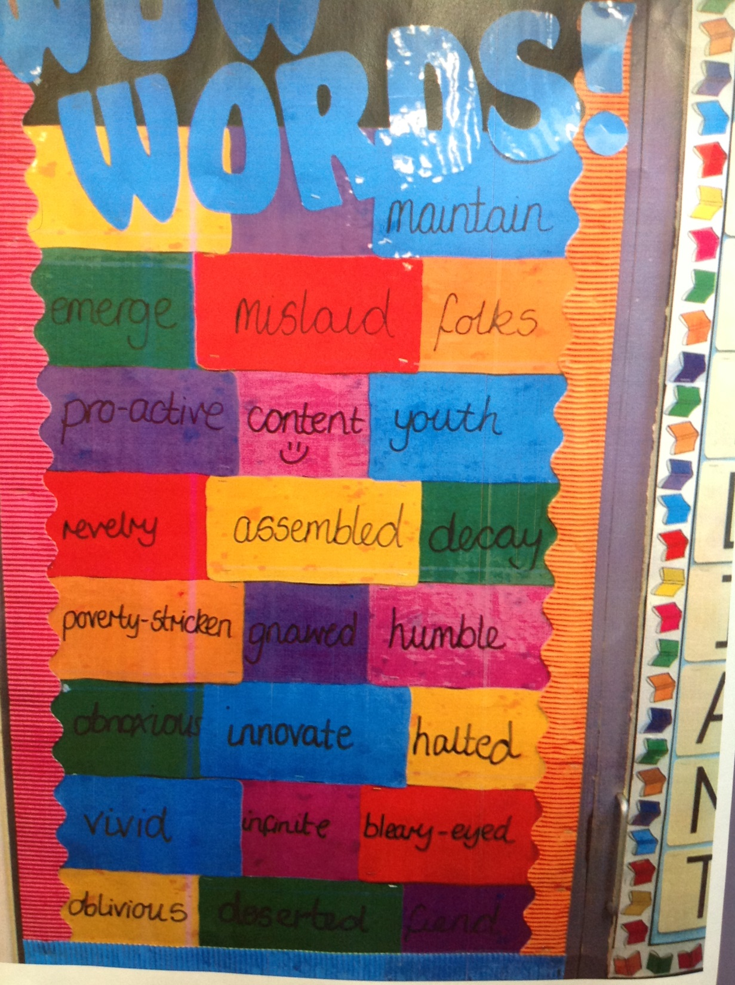
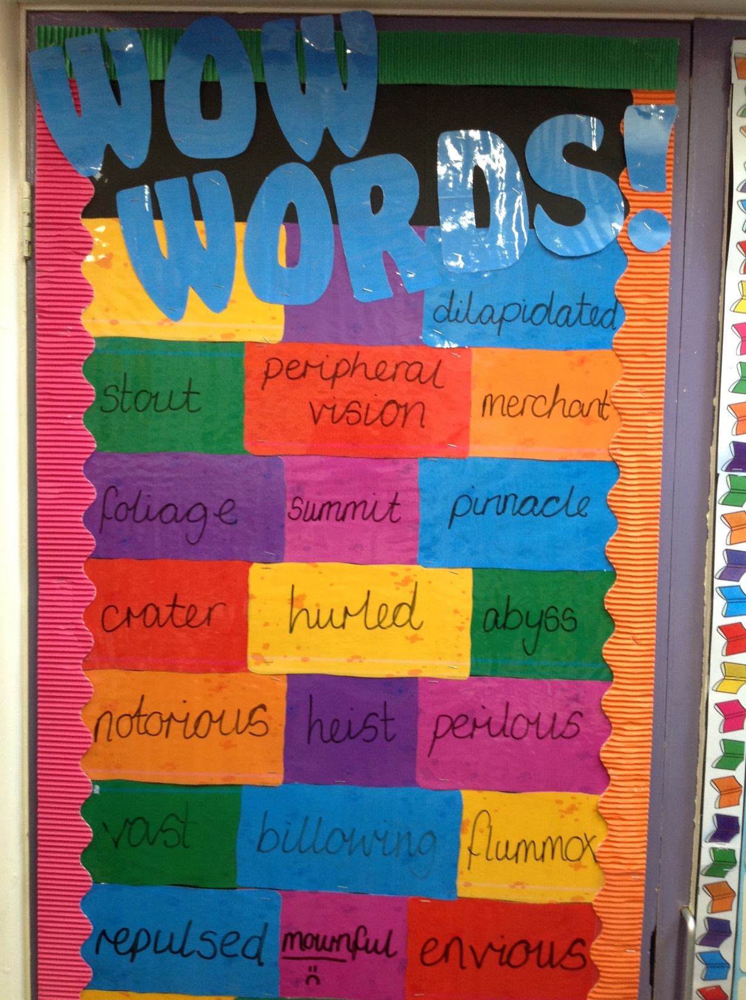
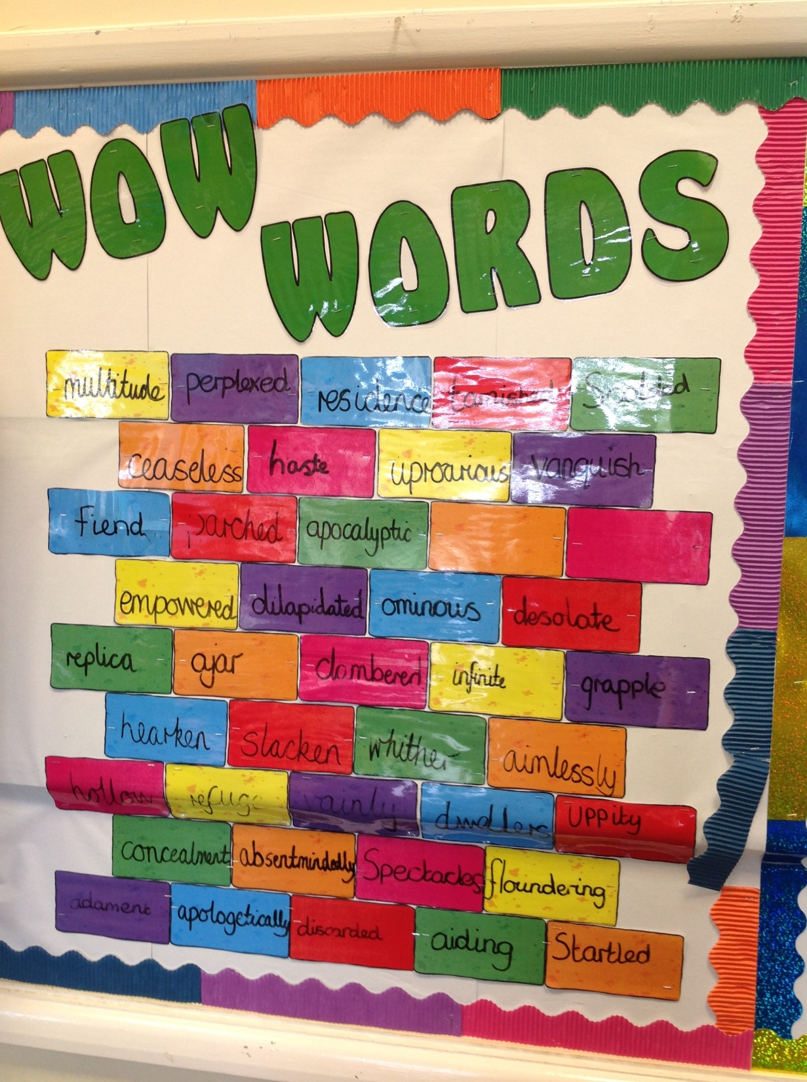
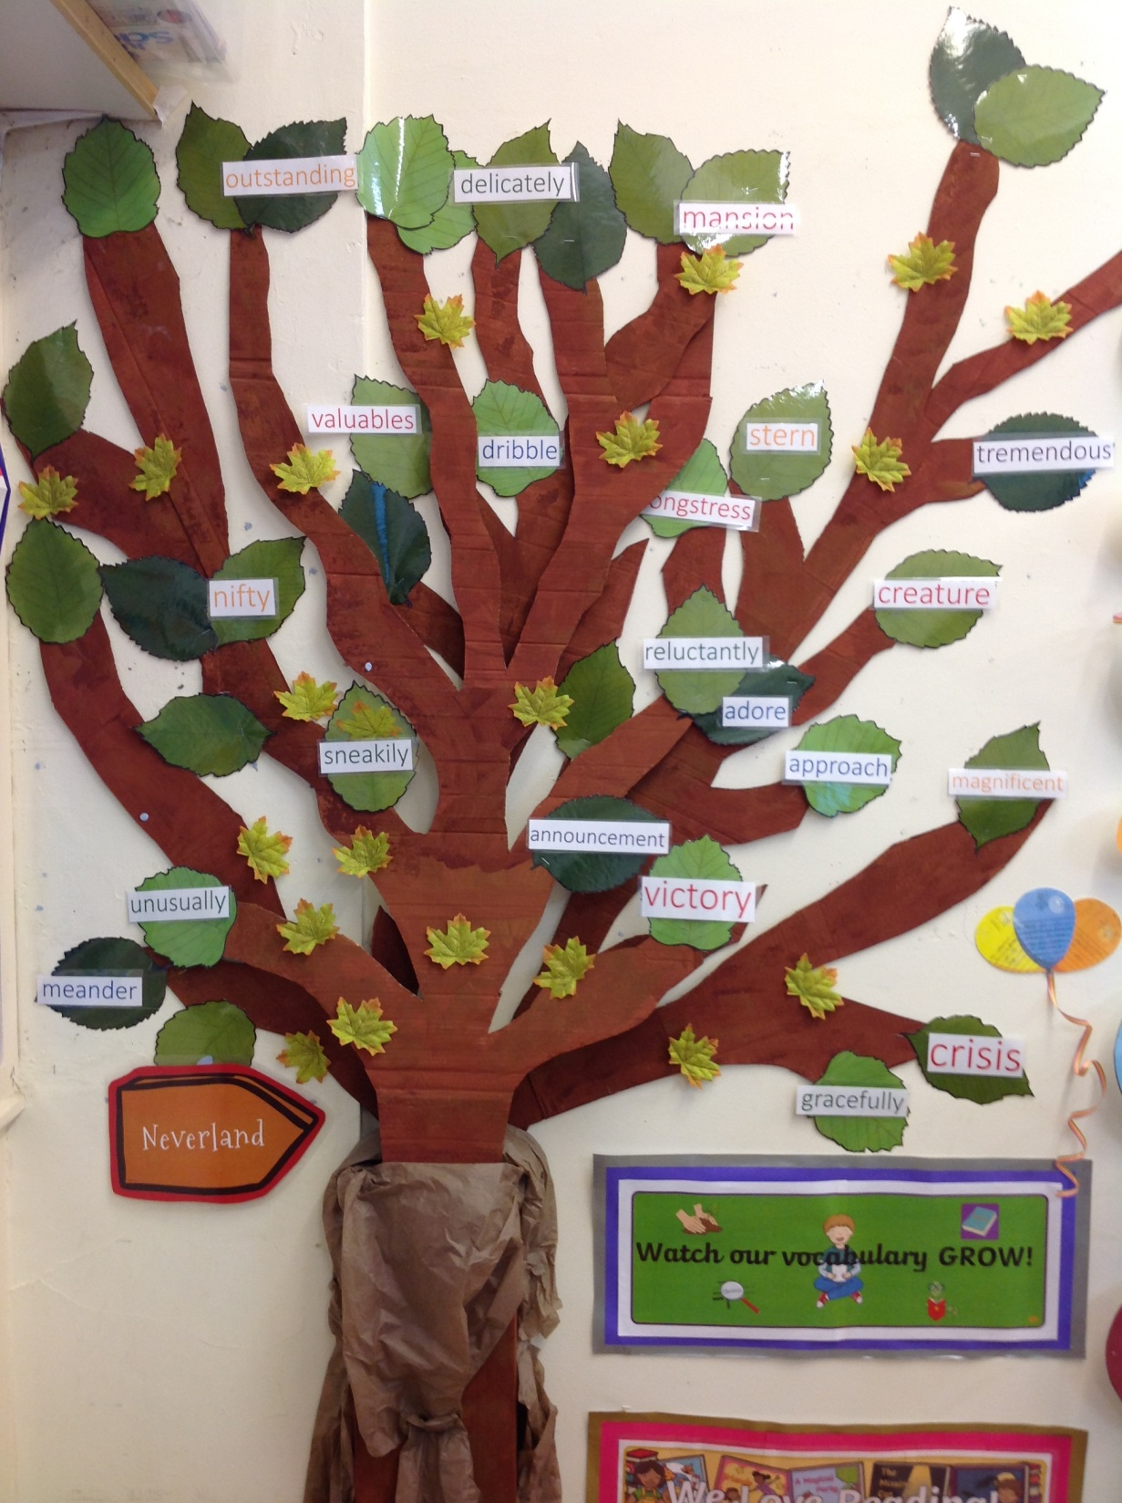
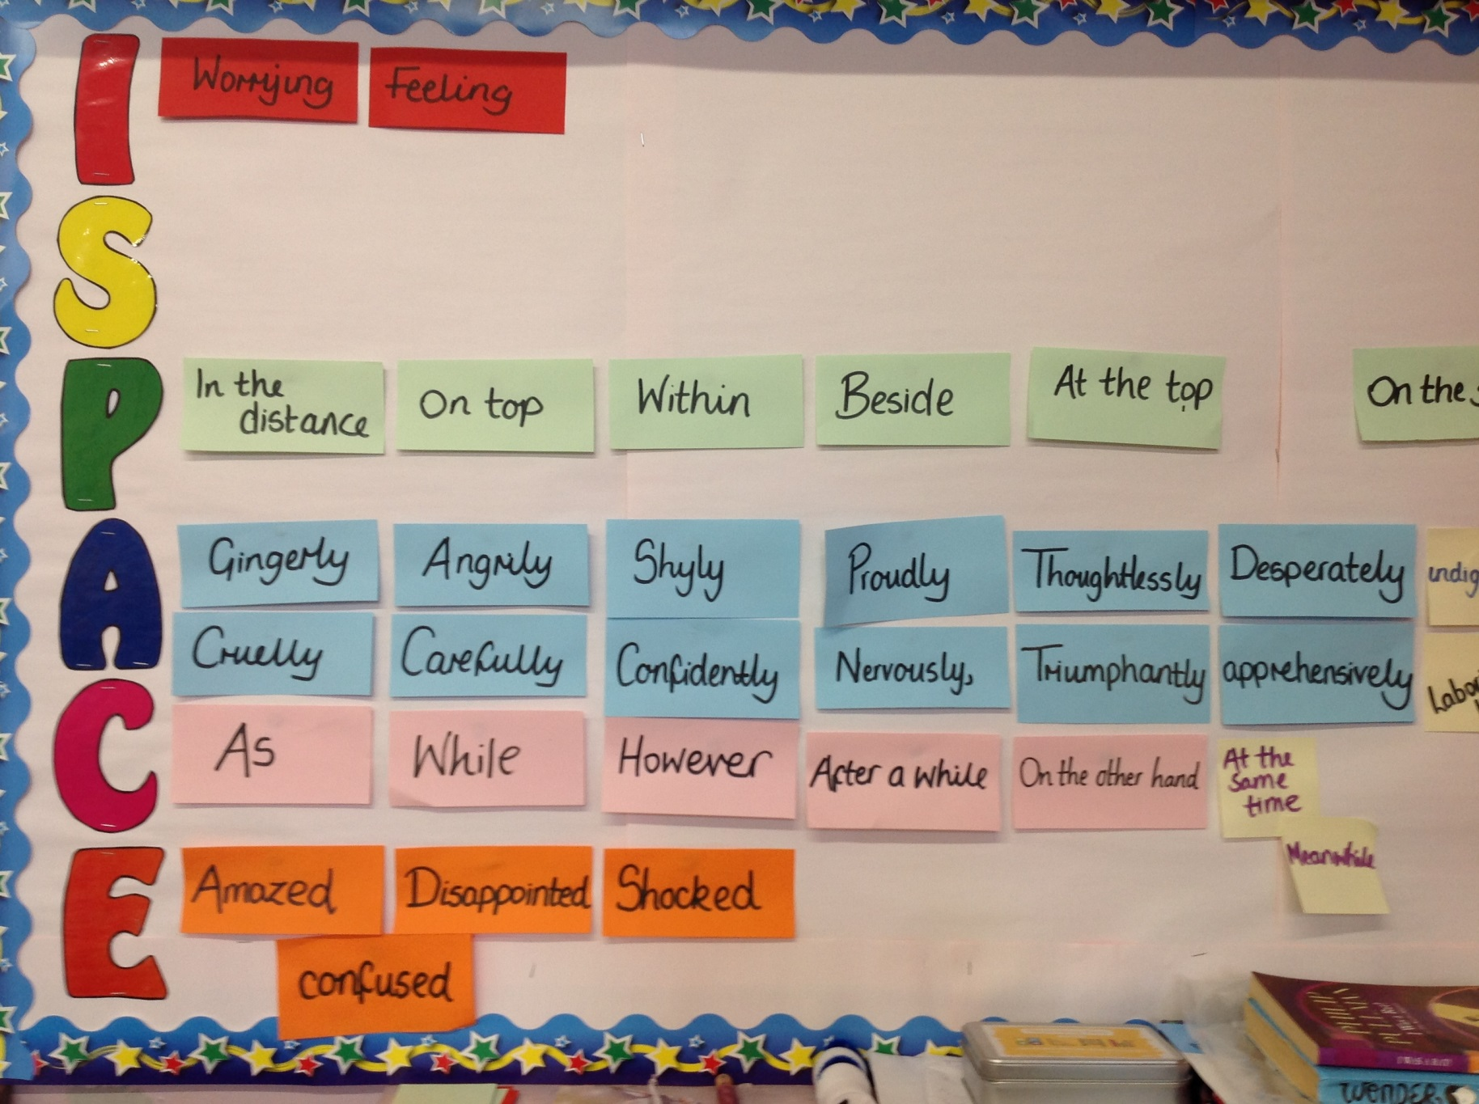
Working Walls – Gathering Content

Slide 22

We are in the process of bringing in the Talk 4 Writing process across the whole school. This involves learning a story orally using a story map, and then innovating the story with the children’s own ideas before writing independently. Research has shown that this method significantly improves sentence structure and organisation, allowing the children to be imaginative with their characters, setting and vocabulary.

Slide 23

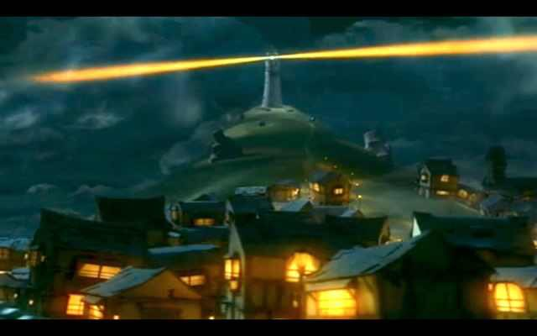
https://www.youtube.com/watch?v=6HfBbSUORvo#action=share

Slide 24
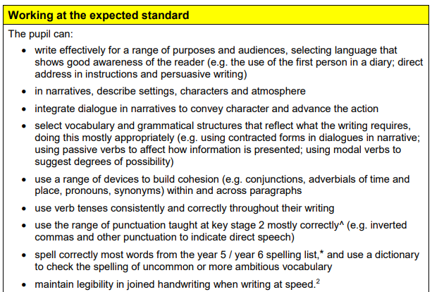
What should they have achieved by the end of KS2?

Slide 25
How can you help?
Encourage the use of high level vocabulary and up-levelling sentence work during homework tasks
Do some short writing pieces linked to the book they are reading
Ask about WOW word walls in school – have they added any new words today?
Write in diaries any interesting words which could be used in class – where appropriate, these can be discussed!

Slide 26
Finally…
As always, we have an open door policy at school – please let us know if you have any queries or concerns
Please complete the feedback form on our Facebook page
Thanks for coming! ☺

