Slide 1


Slide 2
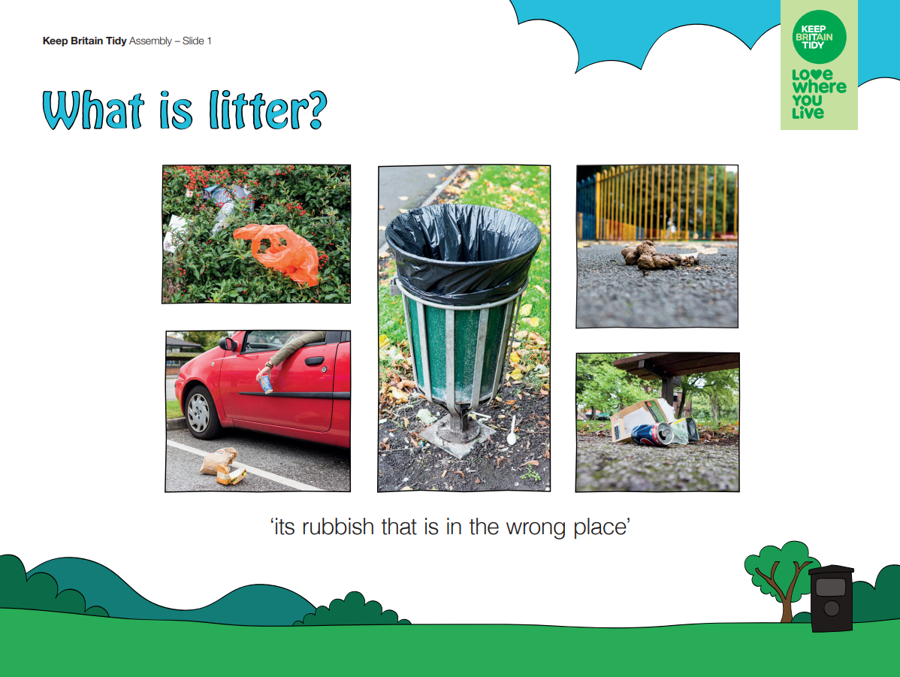

Slide 3
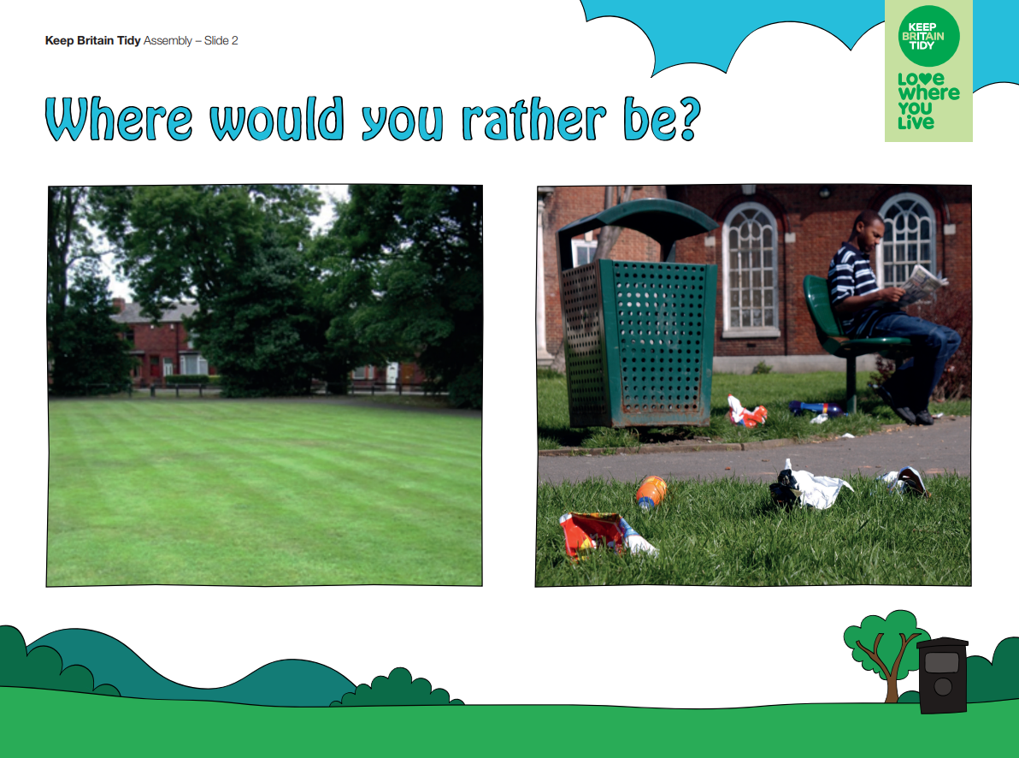

Slide 4
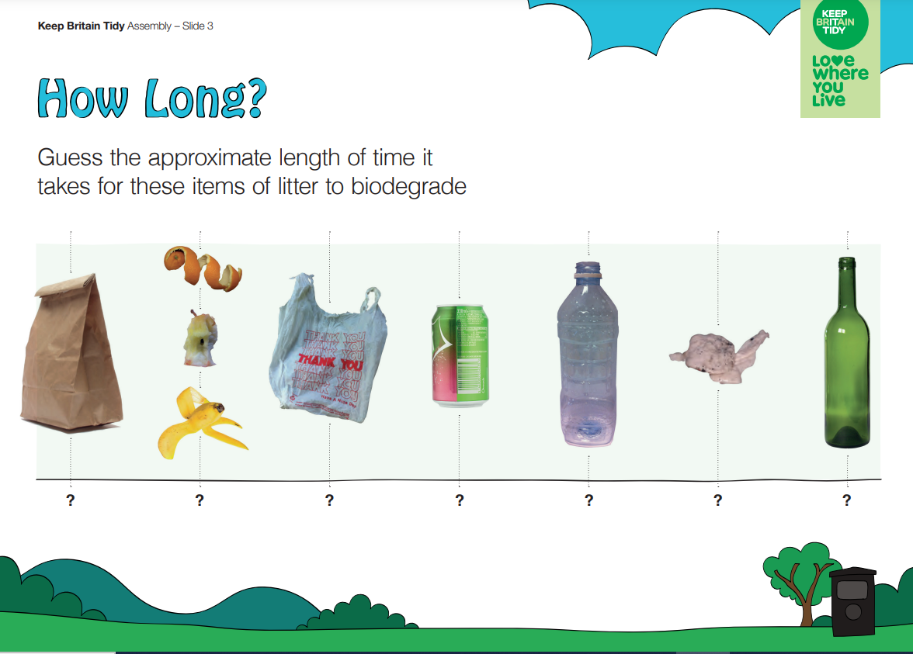

Slide 5
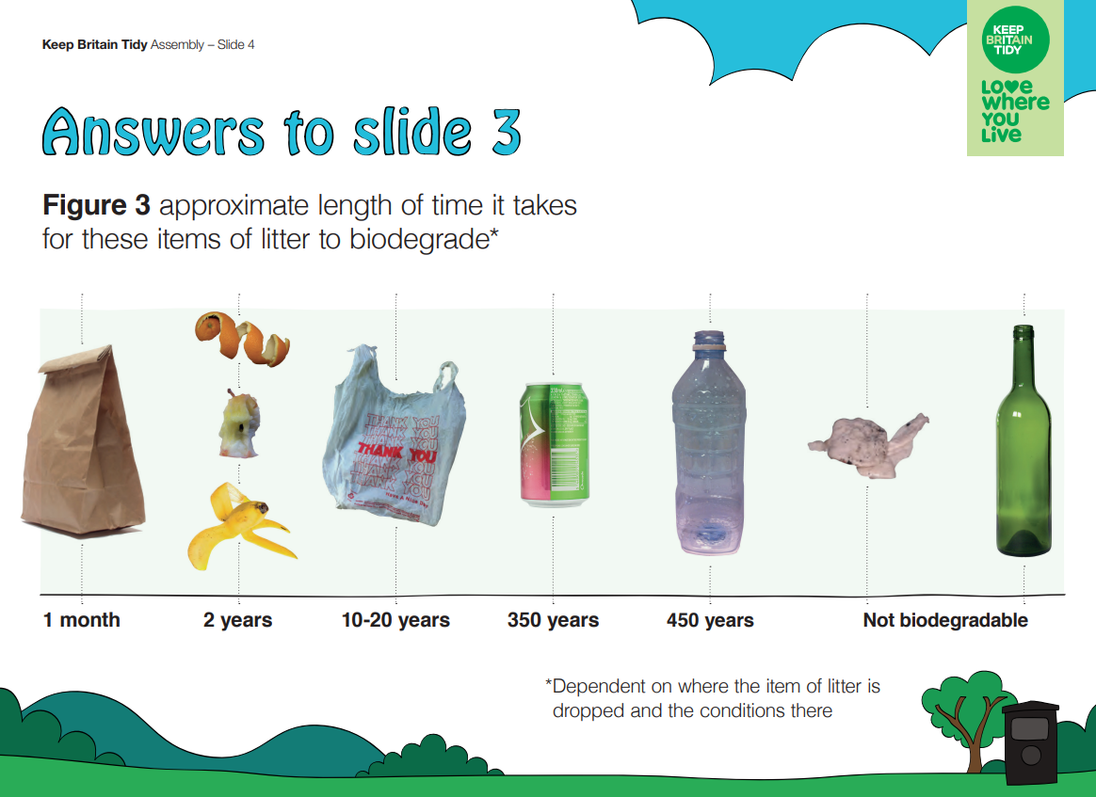

Slide 6
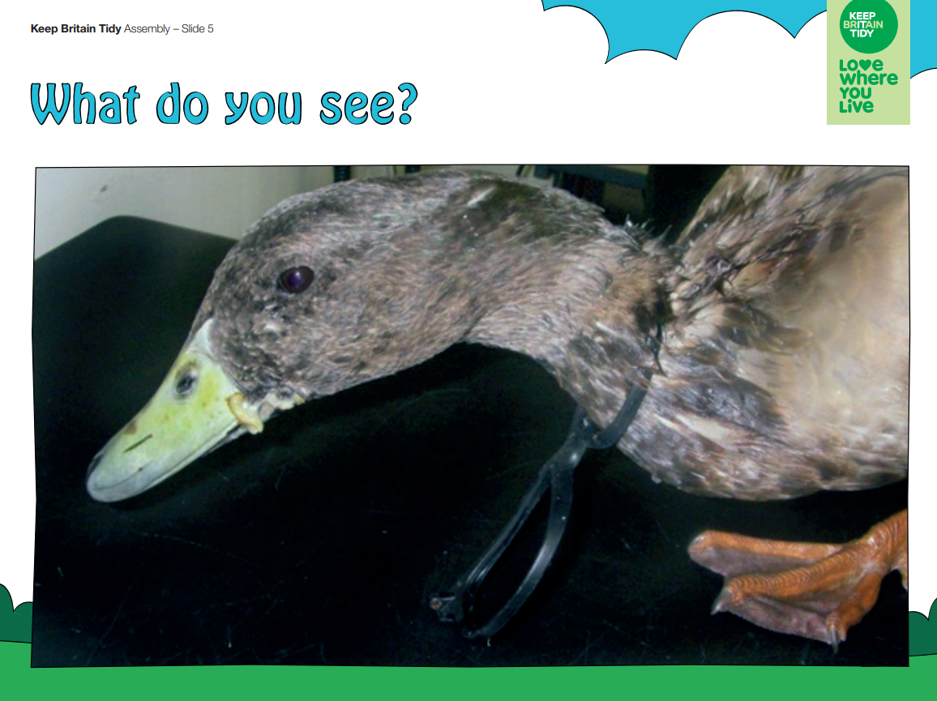
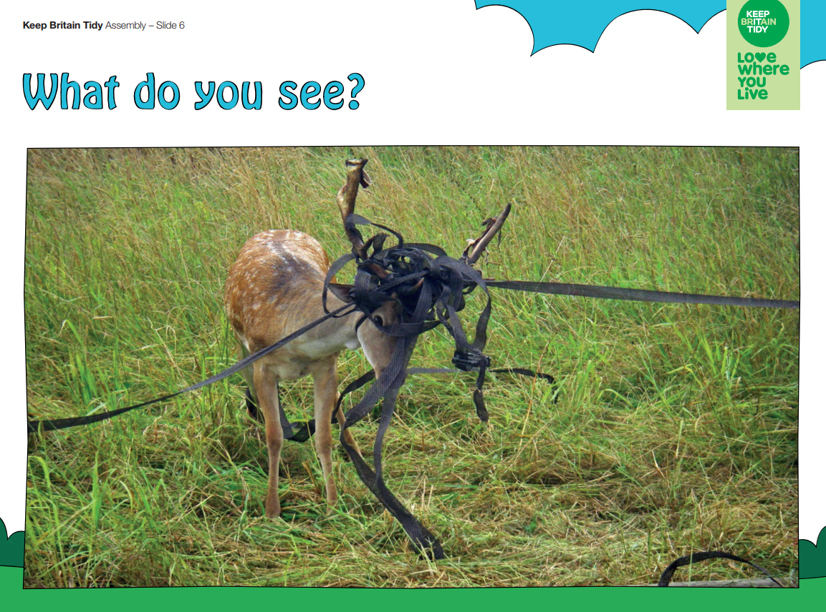
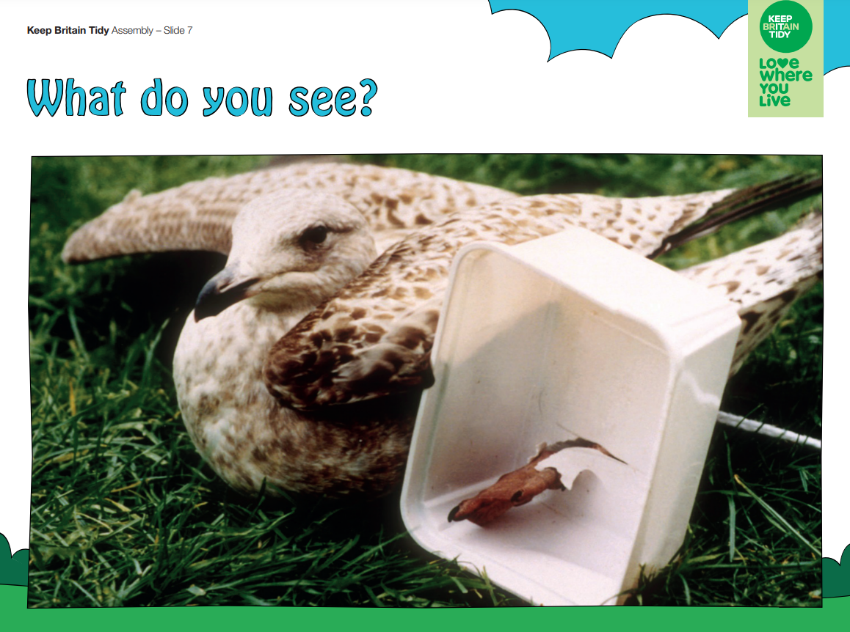

Slide 7
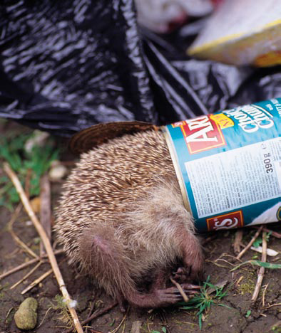
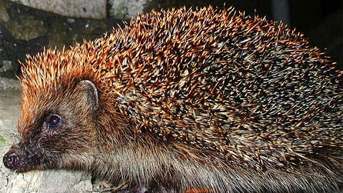
Hedgehogs have a particular problem in that while they can crawl into cans, their spines prevent them reversing out again

Slide 8
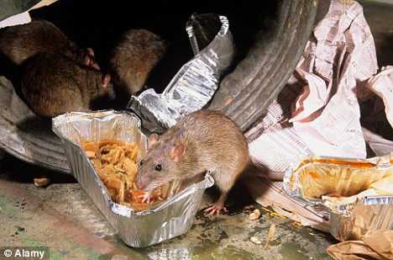
What other problems can litter cause?
Food litter attracts rats

Slide 9
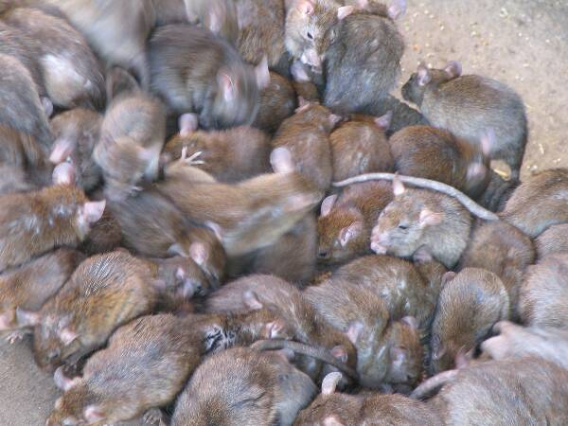
“Rats, rats, rats! Hundreds, thousands, millions of them.”
This is a line from Bram Stoker’s Dracula novel. But reality is getting closer to the fiction.
Experts estimate that there are now 60 million rats in the UK.
That’s one for every person.

Slide 10
What can we do?

Slide 11
Baxenden are taking part in
‘KEEPING BRITAIN TIDY’S’
BIG SCHOOL CLEAN

Slide 12


Slide 13
As a school we have pledge to pick up 40 bags of rubbish!
We would love for you to take part!
We are going to send some information home tonight about how to pick litter safely with your families.
We would love to see your photos – send them via Seesaw - and we have got some prizes to give out for the best ones!

Slide 14

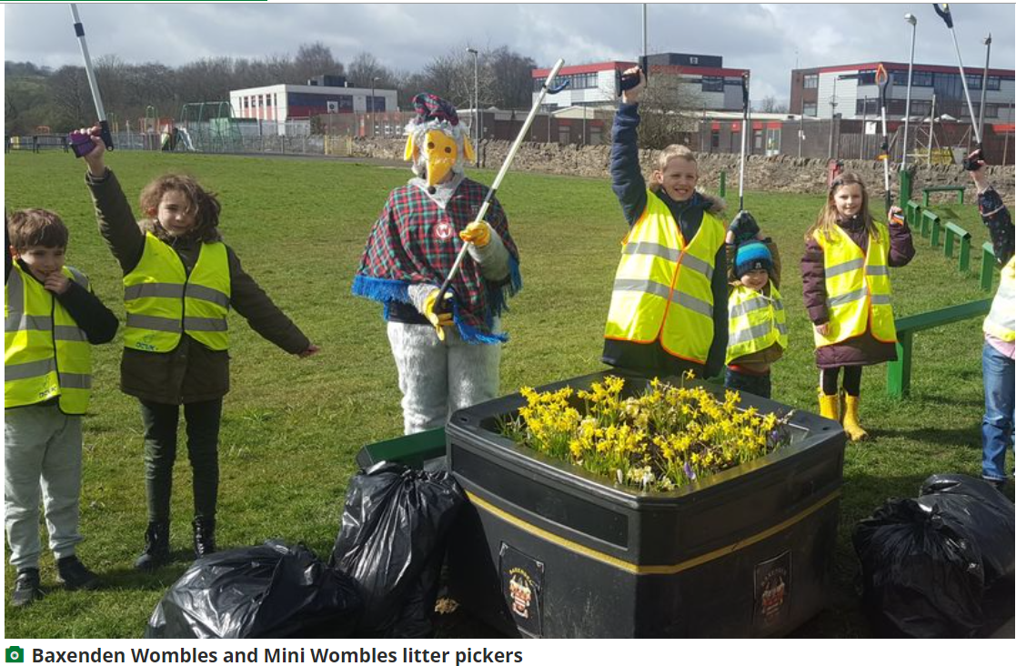
Who are they?
How can we get involved?
What do they do?

