Slide 1

By Harry Bishop - Macdonald

Slide 2
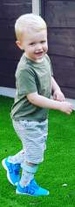
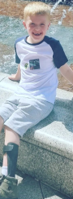
My Name is Harry
I am 6 years old and I am in Year 2
I am going to talk to you today about Cerebral Palsy.
Today is World Cerebral Palsy Day!

Slide 3
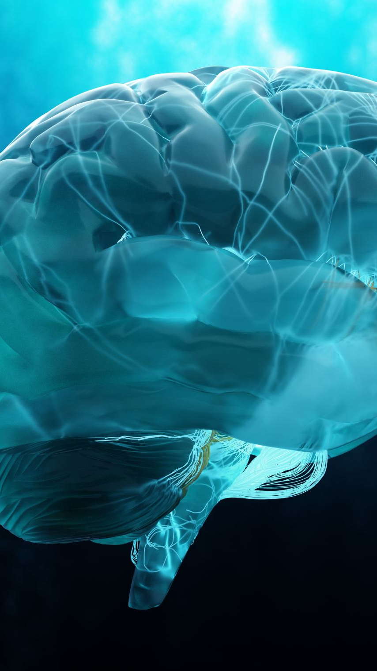
About Cerebral palsy (CP)
Cerebral palsy affects the way a person moves.
Cerebral palsy occurs when there is damage to the brain when it is developing.
It is the most common form of physical disability in childhood.
CP affects every person differently

Slide 4
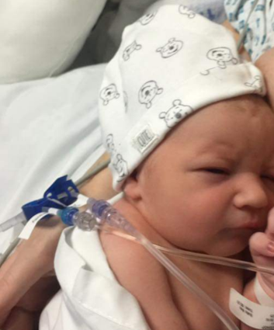
All about me!
When I was 2 years old, I was diagnosed with Cerebral Palsy.
It took me longer to walk when I was a baby
I had a special MRI scan which helped the doctors see why it was harder for me to walk.
My CP affects only my lower legs.
Despite this I can walk, run, and do everything I put my mind to.

Slide 5
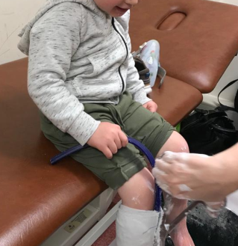
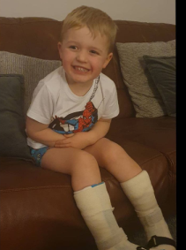
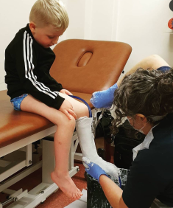
Things that help me...
I wear supportive splints which are made just for me.
I have special plaster cast put around my legs to measure the correct size, I choose my design and they are made specially for me.
They help keep my feet in the right place and help me do all the things I like to do like playing football.

Slide 6
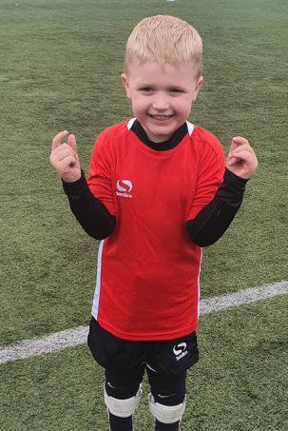
I play lots of sports and exercise
I go to a football club called CP United and play with other children who have CP.
I play basketball every dinner time with my friends.

Slide 7
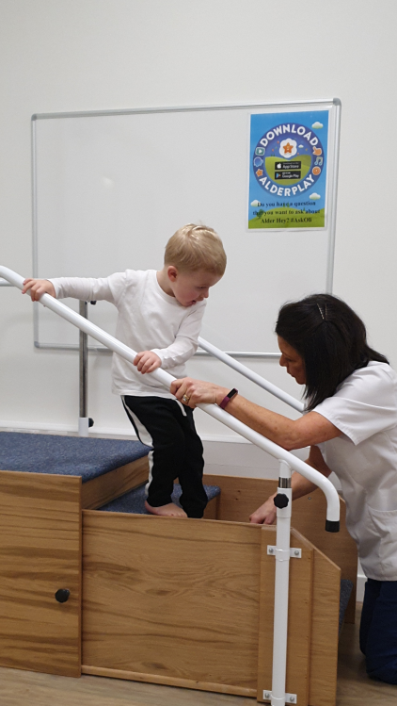
Physio
I have lots of physiotherapy to help keep my muscles strong and flexible.
I have physio in school most days
I see a physiotherapist and do physio and stretches at home
Sometimes this is really hard when I'm already tired after a long day at school.

Slide 8
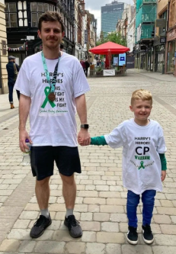
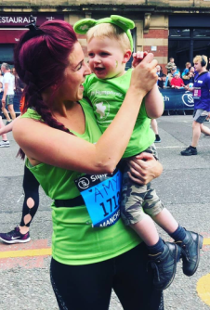
Fundraising
Since I was diagnosed my family and friends have done lots of fundraising to help raise money and awareness of CP to help fund things like physio, splints and anything I may need in the future.

Slide 9
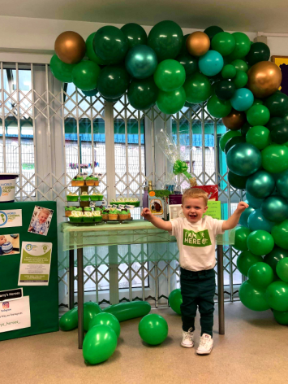
World CP Day!
World CP day is designed to raise awareness of CP, bring attention to CP and the children who live with it.
People wear green ribbons to show support for CP day and will plan events for people to come together and even do fundraisers.

Slide 10

Thank you for listening.

Slide 11
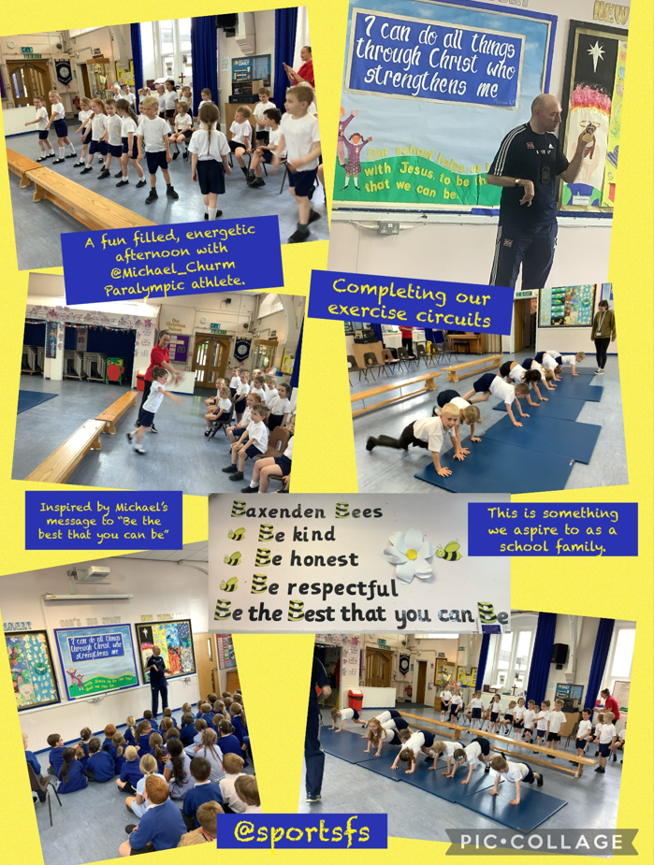
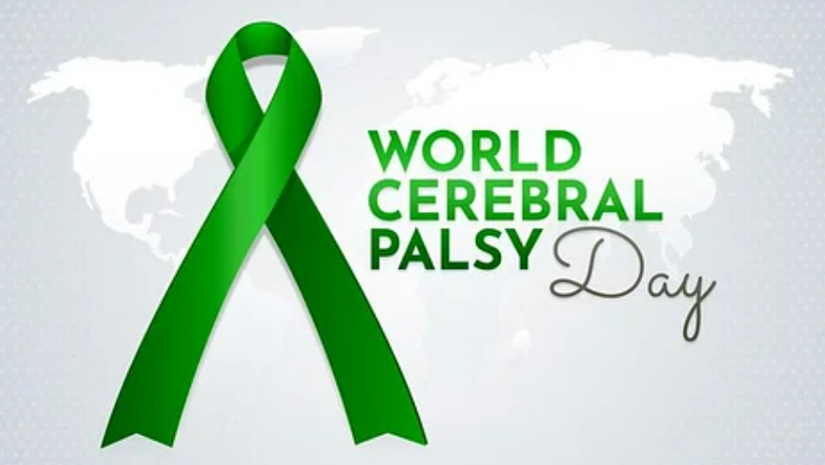
Remembering our visit from
Michael Churm Paralympian

Slide 12
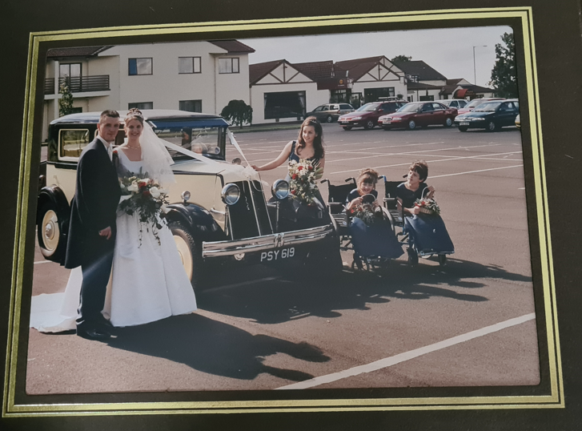
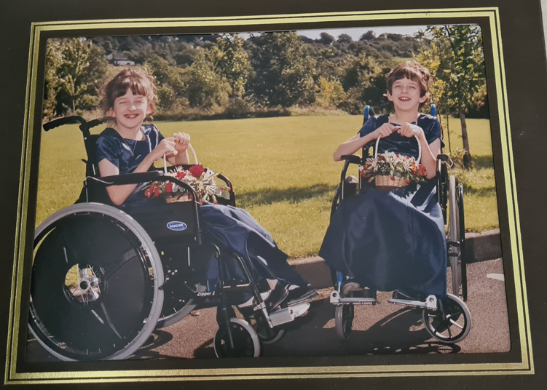
Rachel and Charlotte
Mrs Baynes’ cousins

Slide 13
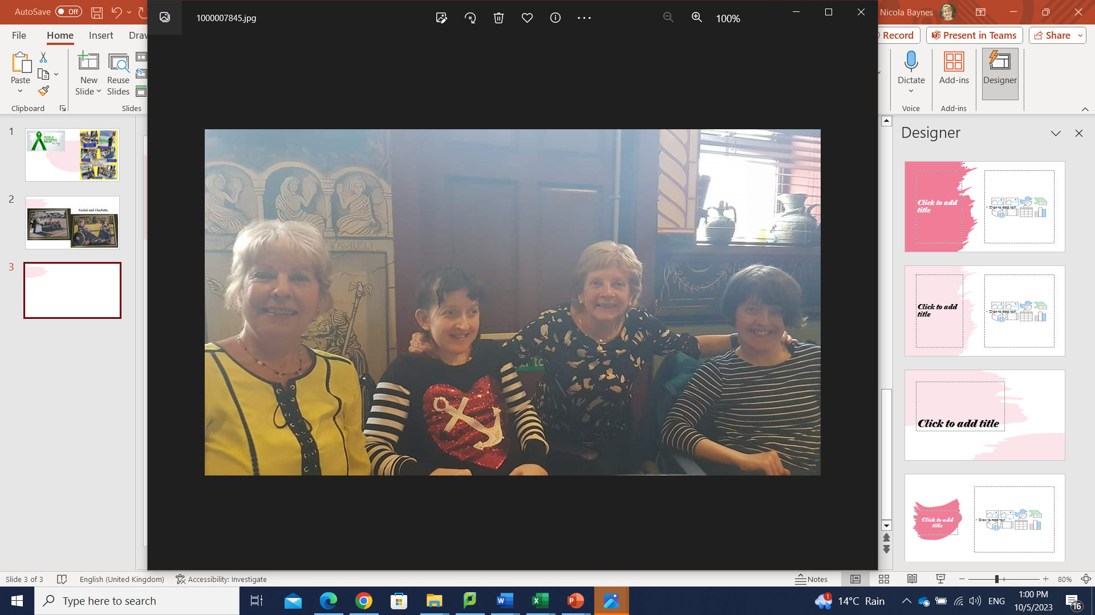
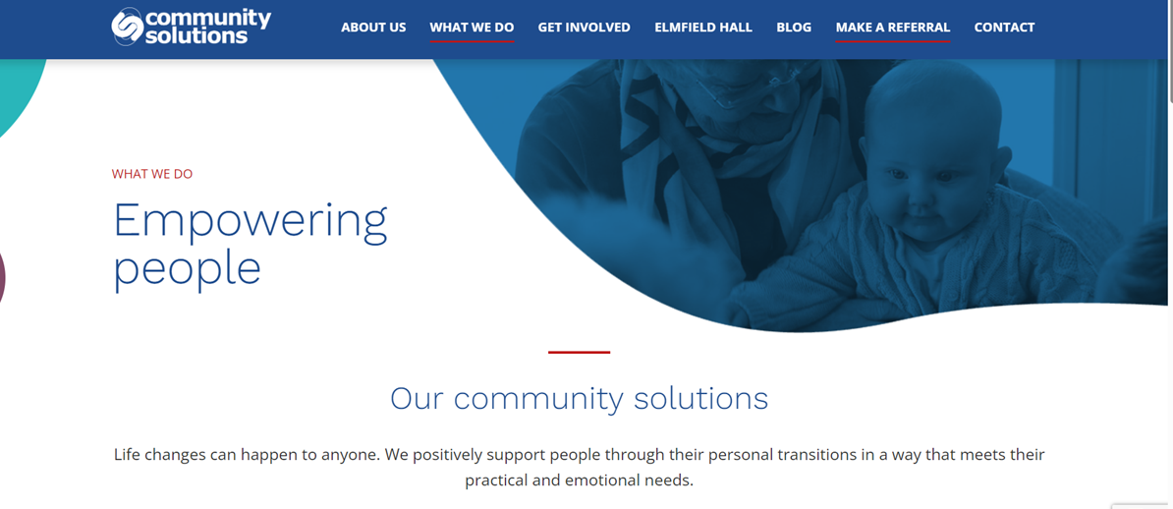
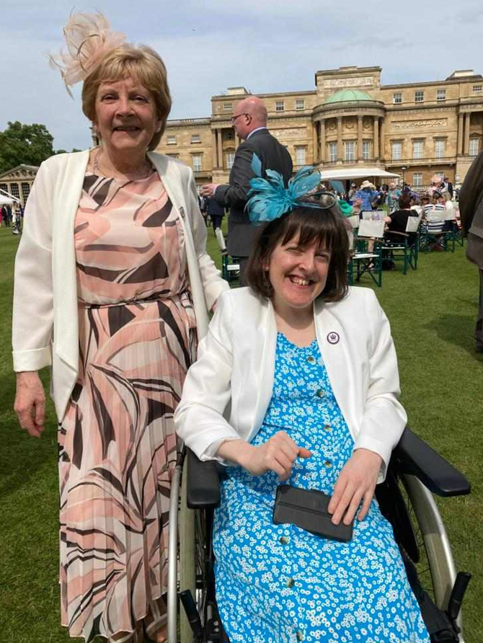
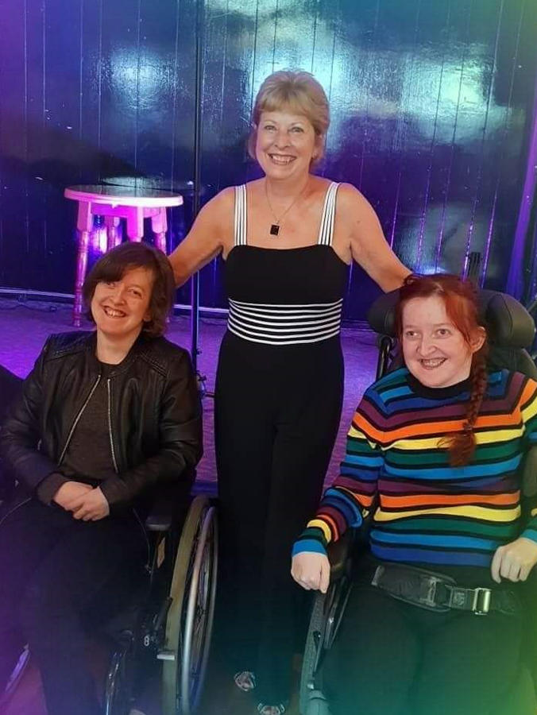
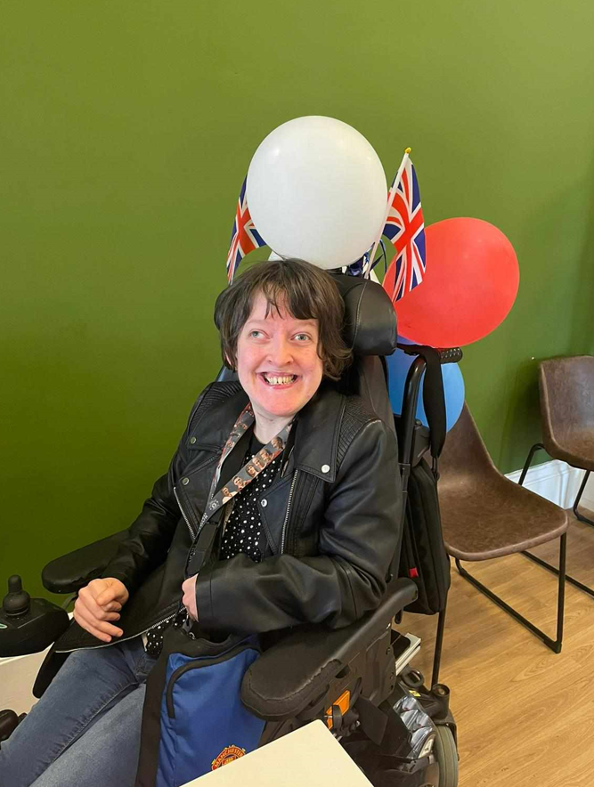
Buckingham Palace Garden Party

Slide 14
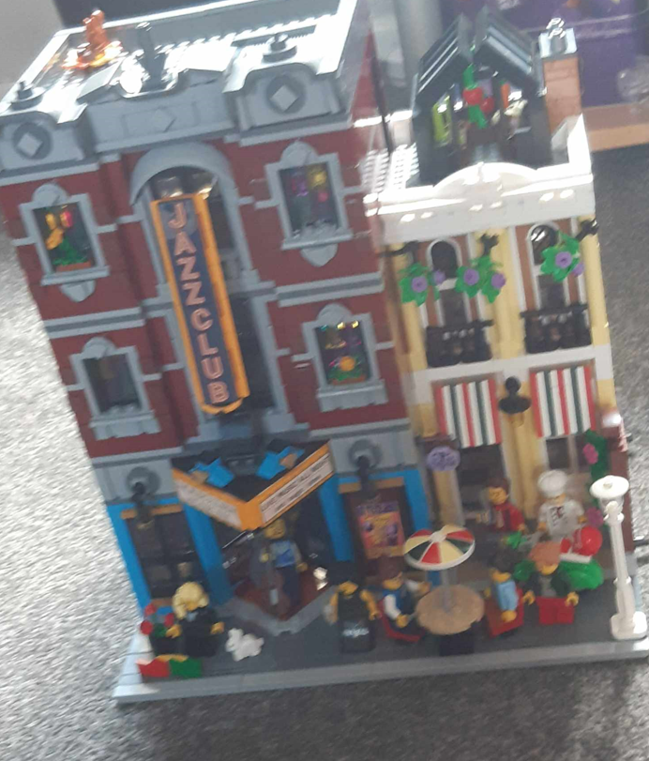
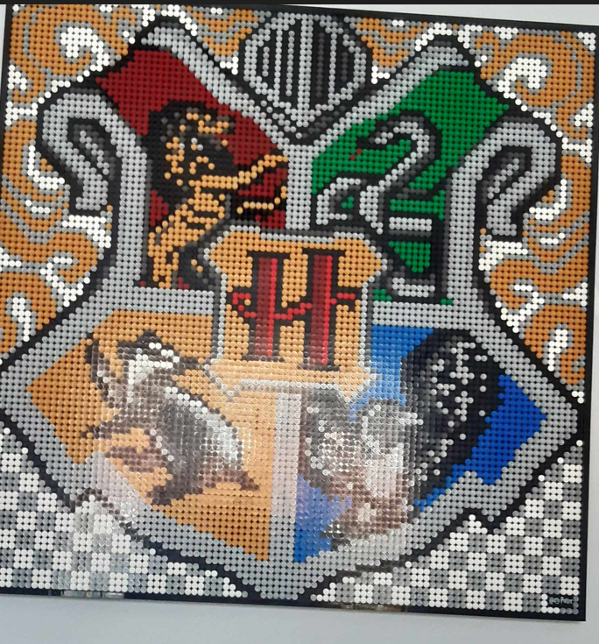
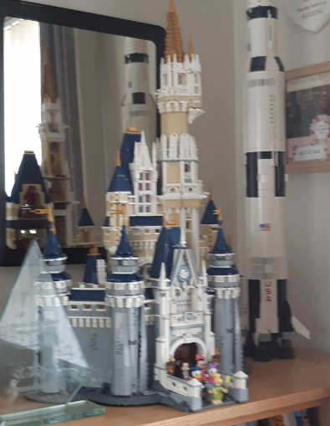
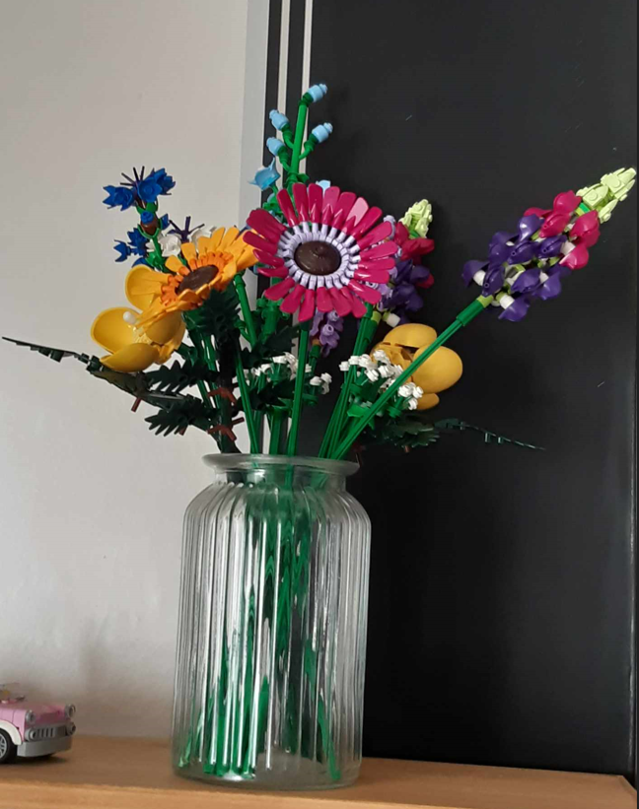
Hobbies-Lego

Slide 15
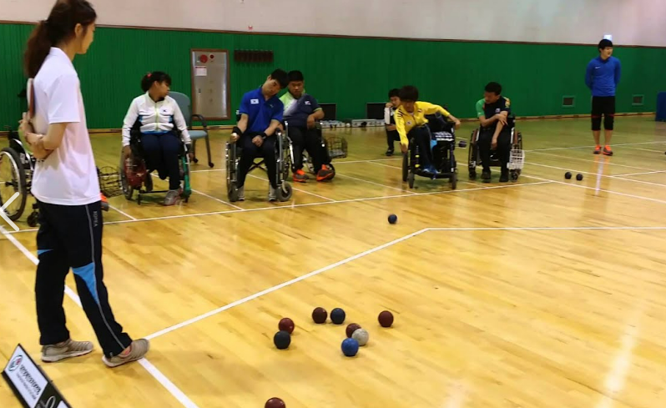
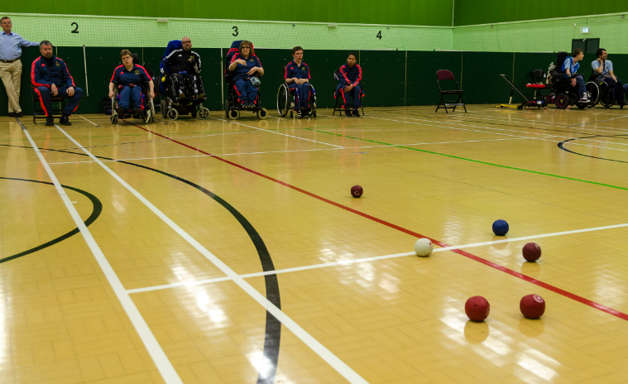
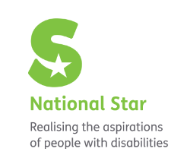
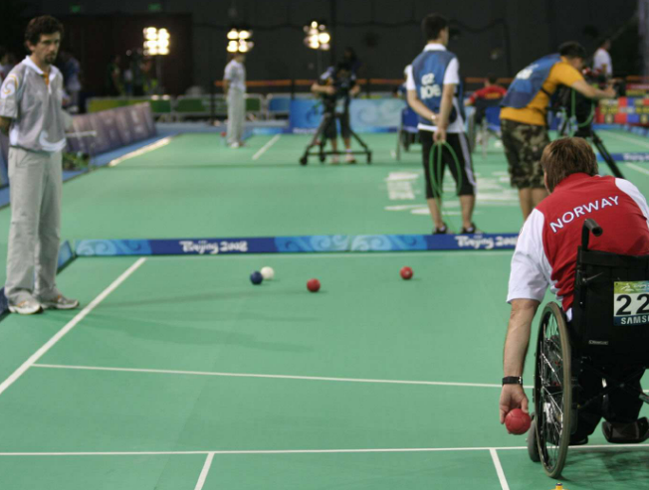
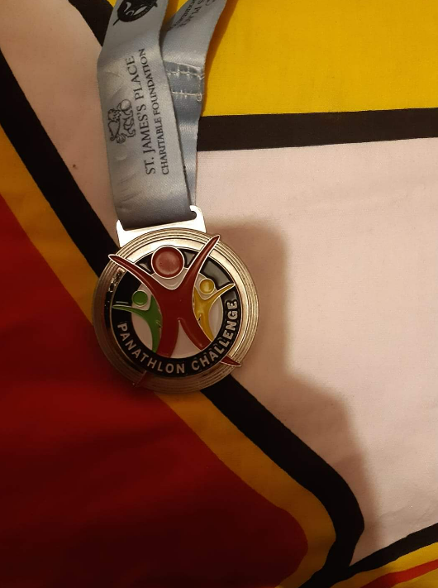
Sport
Boccia
Rachel’s Runner Up Medal Merseyside Open in 2020

Slide 16
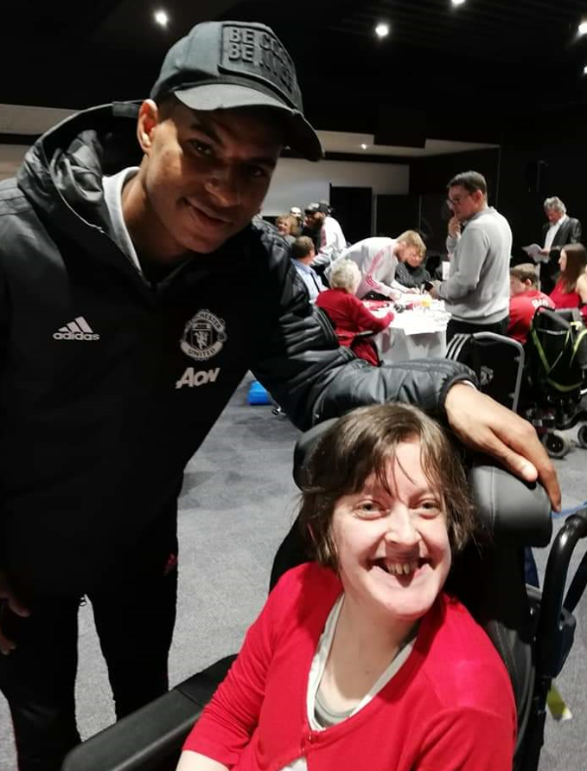
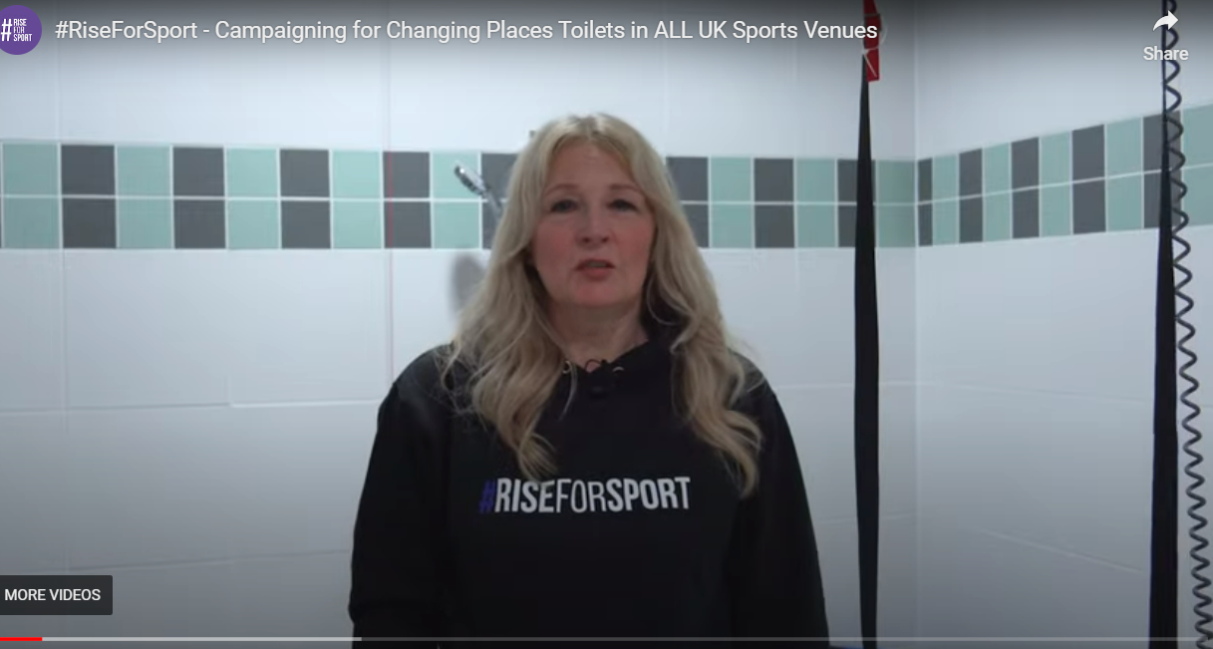
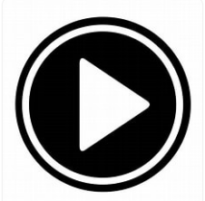
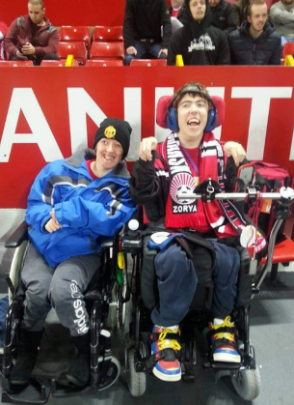
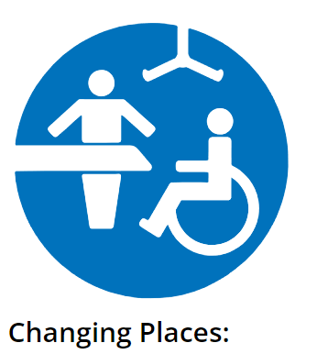
Rachel and Zack

Slide 17
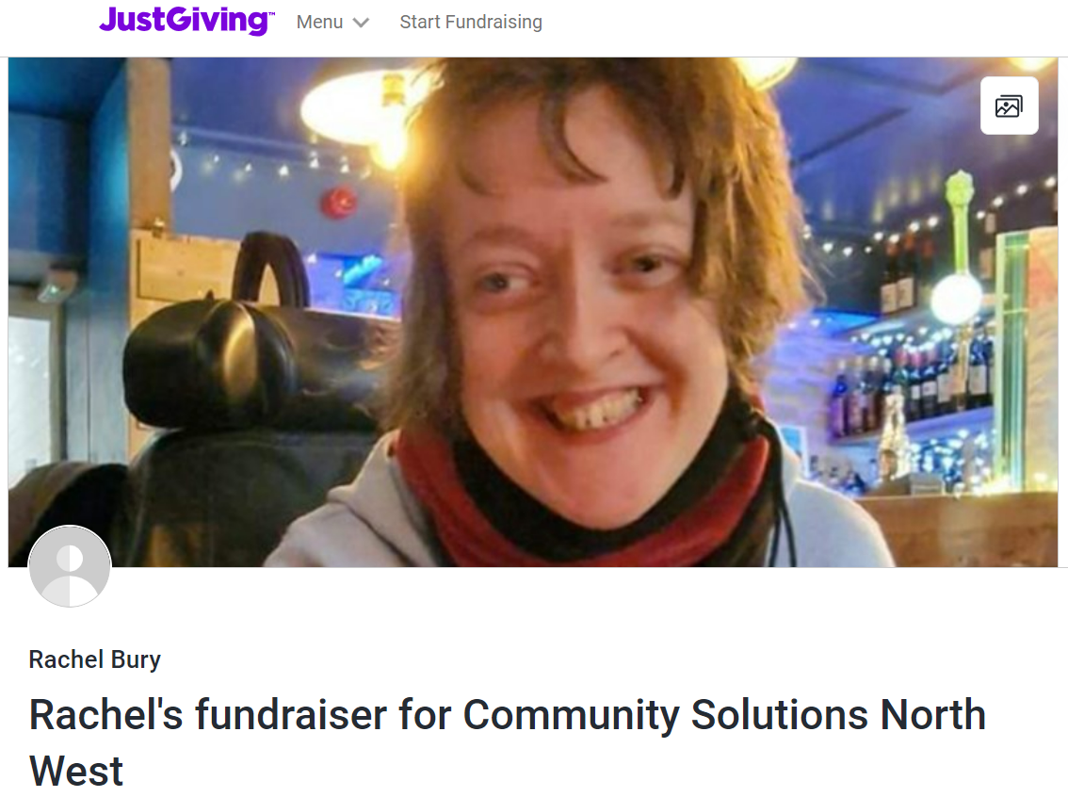
Community Solutions Northwest is a charity based at Elmfield Hall, Church, Hyndburn, that supports some of the most vulnerable and isolated people in our community though a variety of support solutions, many led by our fantastic team of volunteers.
In addition to many and varied social support groups and activities, we offer befriending services, bereavement support, mentoring and counselling, training, employment support, and help for people in crisis.
As a non-profit organisation we rely on grants and donations to help us run our much-needed services. so I have decided that I am doing the Sleepout 2023 challenge for Community Solutions, this will take place on Friday 10th November 2023 at Clitheroe Football Club between 7PM to 7AM ON THE PITCH in sleeping bags with a group of great friends! Money raised will make a real difference to lives of people suffering from loneliness and social isolation.
Anyone who wishes to donate without using online platforms, please get in touch with me or see me in person for the bank details for Community Solutions
Please help me once again to show people that anything is possible regardless of whatever limitations may be in front of you and help people less fortunate in the run up to the festive season.
ANY amount given I would be so thankful for, and you would have my sincere gratitude.
Thank you for reading take care
Rachel xxx

