Slide 1
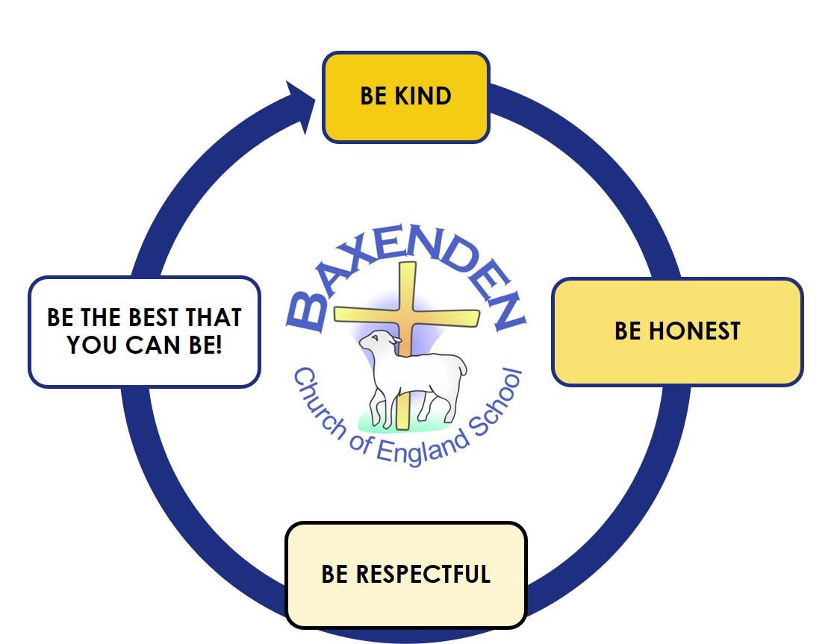
ENGLISH
This half term we will focus on revising, using and applying our phonic skills from EYFS to help compose and write simple sentences. We will initially use rhyming picture books to help support our reading and writing, composing our own sentences to match pictures, using an efficient pencil grip and forming letters correctly. We will then focus on grammar looking at nouns and verbs and how sentences are constructed.
MATHS
Will we begin the term by consolidating skills from EYFS focussing on number and place value, counting forwards and backwards, recognising and writing numerals early addition and subtraction. We will then focus on Number and Place Value Measurement-Length, mass/weight Addition and Subtraction Geometry-2d and 3d shapes
YEAR 1 – AUTUMN 1 TOPIC PLAN
Welcome to the exciting world of Year One. Both myself, Mrs Allen and Miss Davies are excited to work with you and help you settle into your new class. Our first few weeks will be working together to adjust to the learning in year one, developing our class rules and building your independence to know your new classroom. Our learning will then focus on our topic of Penguins, Possums and Pigs, where we will learn all about animals. Our geography will focus on hot and cold places around the world. The curriculum map explains more about what you will learn during your first half term in Year One.
RE
During the first half term we will study the festival of harvest and how and why this is celebrated. We will think about how we can help other who may not have a good harvest. Our World Faith Unit will help us to explore the Jewish Harvest celebration of Sukkot which takes place from Sundown 29th September-Nightfall on 6th October or 7th October Our Christian Value this half term is generosity
MUSIC
Our music unit will explore listening and singing We will develop a sense of rhythm, beat and pulse and learn to play instruments to accompany songs. Our singing unit will be based on The menu Song and our listening unit is Colonel Hathi’s March’
GEOGRAPHY
Do Penguins Sunbathe? Through this topic we will explore, identify and name the seven continents and five oceans of the world. We will discover which places in the world are hot and which are cold. We will use maps, atlases and globes to help us develop our geographical skills.
PE
We will focus on being active and healthy in both body and mind and develop our fundamental movement skills of running, hopping, jumping, throwing, catching and kicking. We will also explore dance movements through a theme.
ART & DESIGN
Incorporating our theme of Penguins, Possums and Pigs we will learn to develop our drawing skills using pencil and pastel We will explore materials and learn how to mould manipulate and join malleable materials to create a 3D animal figure selecting suitable techniques and tools.
SCIENCE
Using our theme of Penguins, Possums and Pigs we will learn how to classify animals We will begin to understand the basic features that different animals (other than humans) have. We will compare, sort and group animals from around the world by different criteria – e.g. body parts, diet. We will explore what animals need to stay healthy and happy
COMPUTING
Our computing will focus on the theme of Computer Systems and Networks. In this unit, pupils will develop their understanding of technology and how it can help us. They will start to become familiar with the different components of a computer by developing their keyboard and mouse skills. Learners will also consider how to use technology responsibly. We will also look at E-Safety – Year 1 Rule Writers.
PSHE
During the first half of the Autumn Term, we will focus on the theme of Me and My Relationships. This will cover; Classroom Rules, Our Feelings, Feelings and Bodies, Special People, Good Friends and Listening
Our school helps us to walk with Jesus, to be the best that we can be.

