Slide 1
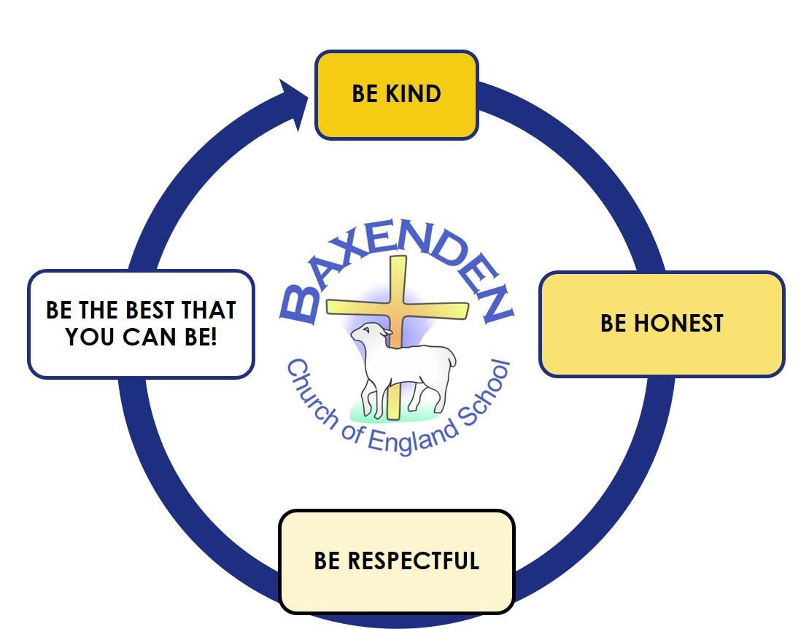
ENGLISH
This half term we will focus on revising, using and applying our phonic skills from our phonics lessons to help compose and write, read back and edit simple sentences which make sense. We will develop our understanding of how sentences are formed identifying and using verbs, subjects, pronouns and adverbials of where. Our focus book will be Traction Man is here.
MATHS
Our focus learn this half term will be based on Geometry 2d and 3d Sequencing and sorting Fractions Capacity and Volume Money Time We will continue to develop skills using concrete, pictorial and abstract methods to help us solve problems.
YEAR 1 – AUTUMN 2 TOPIC PLAN
Both myself, Mrs Allen and Miss Davis are excited to work with you on another exciting topic. We are so proud of the determination and independence you showed in Autumn 1 and are excited to see what you can do this half term. Our learning will focus on our topic of Family Album, where we will learn all about the history of toys and explore which toys our grandparents played with. The curriculum map explains more about what you will learn during your second half term in Year One.
RE
During this second half term we will focus on Christmas and explore why Christians, give and receive gifts. We will explore the best gifts and gifts that money can’t buy. We will develop our understanding that Jesus is God’s Gift to the world. We will find out more about the Wise Men and why their gifts are an important part of the Christmas Story.
HISTORY
What did my grandparents play with? In history and through the focus of history of toys we will being to learn about chronological framework placing key people, objects and events in order using phrases that show the passing of time. We will explore the changes that have taken place from birth to current age. We will introduce the term ‘generation’ related to close family members and begin understand the differences and similarities between toys now and in the past.
SCIENCE
Our science work this half term focuses on Seasons. We will explore and observe the changes from one season to another including the weather features and the clothes we wear. We will look at daylight hours and how these change during each seasons.
ART & DESIGN
We will continue to learn to develop our drawing skills using pencil and pastel We will look at creating self- portraits by studying famous portrait artists. We will also develop skills in mixing colours to create different shades.
COMPUTING
Our focus this half term is “Creating media-digital painting” During this unit, learners develop their understanding of a range of tools used for digital painting. They then use these tools to create their own digital paintings, while gaining inspiration from a range of artists’ work. The unit concludes with learners considering their preferences when painting with and without the use of digital devices. Our eSafety unit we focus on “We are kind and thoughtful”
MUSIC
Our music unit will explore listening and appraising music and singing songs showing awareness of pace and pitch. We will learn to play instruments for our Christmas Nativity developing our understanding of the beat.
PSHE
During the first half of the Autumn Term, we will focus on the theme of Valuing Differences This will cover; Same or different, Unkind, tease or bully?, Harold’s School Rules, Who are our special people? It’s not fair! We will also participate in Anti-bullying week WC 10/11/2025
PE
We will focus on being active and healthy in both body and mind. We will look at developing fundamental movement skills (FMS) including, bouncing a ball and catching. Our FMS in gymnastics will focus on ways to travel, roll and jump using Jack and the beanstalk as a theme.
Our school helps us to walk with Jesus, to be the best that we can be.

