Slide 1
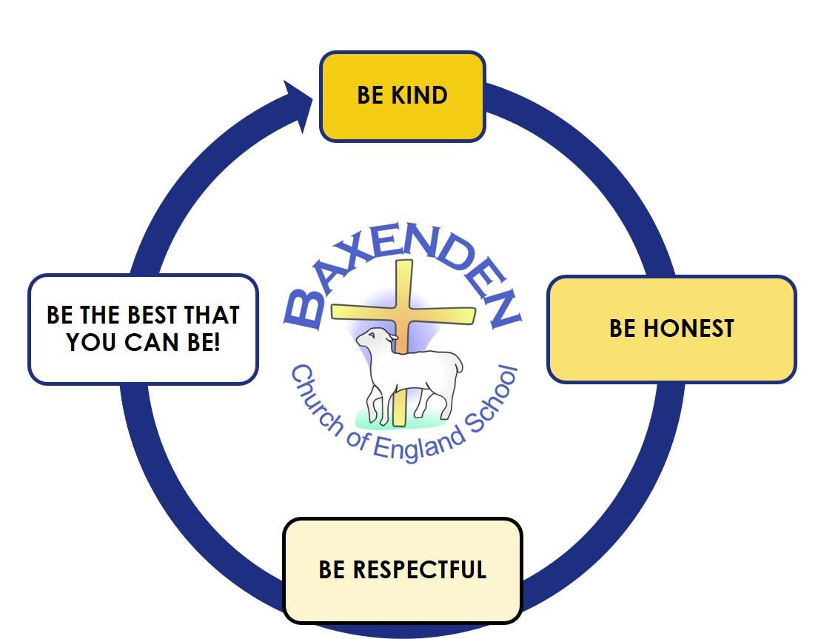
ENGLISH
This half term we will refine our writing skills, applying our phonic knowledge and developing our vocabulary to add interest through adjectives and verbs. We will develop detail through the use of conjunctions and, so, but, because. We will work hard to improve our editing skills, handwriting, letter formation and presentation in preparation for year 2. Based on Peter Rabbit our work will feature poetry and narrative.
MATHS
Our focus learn this half term will be based on Time Number and Place Value Addition and Subtraction Fractions Multiplication and division We will continue to develop skills using concrete, pictorial and abstract methods to help us solve problems. We will continue to learn to count in 2s 5s and 10s
YEAR 1 – Summer Two TOPIC PLAN
WOW! We have made it to our final half term, well done for showing supper effort and making great progress this year, both myself and Mrs Allen are super proud of you. Our final topic is one of my favorites. We will be using the theme of Robots to explore our senses in science-using the outdoors and Forest School to enhance this. We will also design and make our own robot in DT exploring how to use tools such as hacksaws, hammers, screwdrivers and glue guns.
RELIGIOUS EDUCATION
During this half term we will focus on Creation. We will explore stories from the Bible, comparing this to versions of creation in other faiths-Hindu and Islam. We will develop our own creativity, explore ideas about believers understanding of creation and express our feelings about our favourite parts of creation.
MUSIC
Children will explore songs, rhythm, pulse and playing both untuned and tuned instruments. They will explore call and response and echo singing. They will be introduced to musical notation /vocabulary.
Design Technology
We will design and build our own robots/trains. This will be a woodwork focus allowing us to develop skills in measuring, sawing, sanding, hammering, drilling, screwing and gluing. We will discuss ways to keep safe when using these tools
SCIENCE
Our science work this half term focuses on senses. We will explore our five senses through opportunities in Forest School. We will harvest our potatoes plants from our learning earlier this years” and make potato soup on the campfire in Forest School
PHYSICAL EDUCATION
We will focus on being active and healthy in both body and mind. Through our topic of “OAA focussing on trails” In Athletics we will look at running fast, changing direction quickly and jumping and landing safely.
Geography
Our School Grounds-In this unit, children explore their school grounds, naming and describing what they see (e.g. different areas: buildings, playgrounds, planters, sensory gardens, field, forest school) and how these areas are used. Children will study data collection methods and choose appropriate methods according to their enquiry.
COMPUTING
Our focus this half term is “ Programming B. We will be exploring scratch, comparing tools, adding blocks, creating sprites, making and following designs. Our e-Safety unit-”I am a responsible gamer” focusses on using gaming technology safely.
PSHE
During the seconds half of the Summer Term we will focus on the theme “Growing and Changing” This will cover; Inside my wonderful boy, how to look after a baby, then and now, who can help? surprises and secrets, keeping privates private. We will continue to work on developing a growth mindset as we prepare for our transition to year 2. Our Christian Value “Living the Faith” this half term is “Service” ”
Our school helps us to walk with Jesus, to be the best that we can be.

