Slide 1
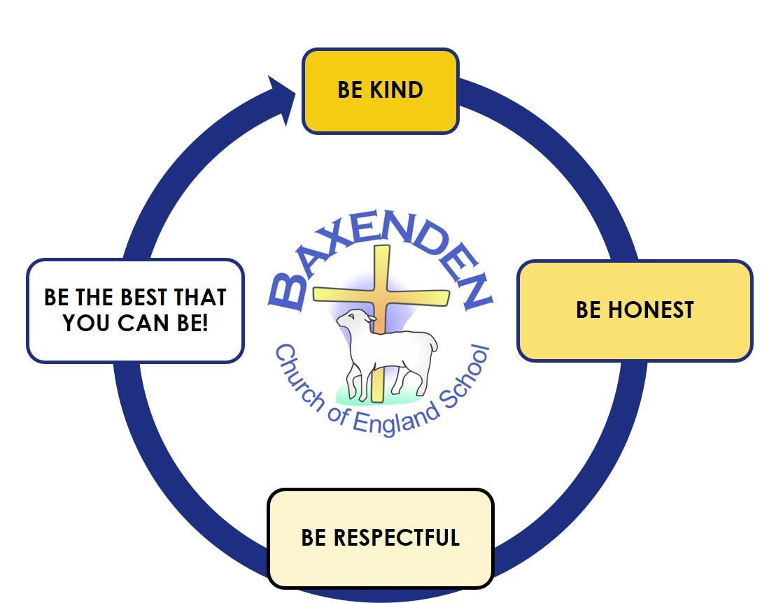
GRAMMAR/ SPELLINGS
During the first part of the Autumn term we will be focussing on developing our grammar skills. We will be learning about the different types of nouns and verbs. These lessons will be daily and will provide children with good foundations for starting the English units in Autumn 2. We will also have daily spelling lessons using the Lancashire Red Rose spelling scheme.
MATHS
We will be doing lots of learning in our Maths lessons. We will be starting the half term by recapping some of the number skills that were covered in year one. Our lessons will then include: Recognising two-digit numbers Partitioning numbers in lots of different ways. Adding and subtracting two-digit numbers. Recognising and describing the properties of 2D and 3D shapes.
YEAR 2 – AUTUMN 1 TOPIC PLAN 2026
Hello and welcome to your first half term in Year 2. Myself and Mrs Allen can’t wait to get started with the many activities we have planned for you. Our first few days will be spent completing lots of ‘getting to know each other activities as well as starting our Year 2 curriculum. The curriculum map sets out all the key learning that will take place this half term but if you have any further questions ,then do not hesitate to contact me. We very much look forward to the year ahead with you. ☺
RE
This half term we will be studying the unit of ‘The Bible’. Throughout this unit we will be learning why the Bible is such a special book for Christians. We will also be thinking about things which we consider to be our ‘treasured possessions’. Our RE lessons will include a combination of art, drama, stories and written work.
MUSIC
This half term we will be having fun with singing. We will be using the ‘Sing Up’ lessons during music. Our singing unit 1 is ‘Tony Chestnut’ Our listening unit is ‘Carnival of the animals’
HISTORY
Our History topic this half tem will be ‘Hospitals and Healthcare’. During this topic we will be investigating the questions of ‘ How did Florence Nightingale and Edith Cavell help to improve hospitals?’ We will discuss different ways that we can find out information about the past and will make links between the past and the present.
ART & DESIGN
In Art we will developing our drawing, painting and printing skills. Throughout the half-term, we will be studying the work of George Seurat and will produce our own pieces of artwork inspired by some of his famous pieces.
SCIENCE
Our topic this half term is: Animal Survival and Growth, this will include learning about: Animals and their offspring. We will explore whether all animal babies look like their parents. Finding out and describing the basic needs of animals for survival, including food, water and air.
PE
This half term our PE lessons will be on a Tuesday and a Thursday. During our PE and Games lessons we will be practicing both overarm and underarms throwing. We will also be developing simple tactics for playing team games.
COMPUTING
We will begin the half term with an E-Safety lesson to help ensure that we are safe when using the computers and other devices. Our IT unit this half term is ‘IT around us’. During this unit we will be learning about; IT in school, IT around the world and the benefits of IT.
PSHE
During the first half of the Autumn term all of our PSHE lessons will focus on the topic ‘Me and My Relationships’. We will discuss the importance of being able to talk about our feelings, our friendships and the difference between bullying and teasing.
Our school helps us to walk with Jesus, to be the best that we can be.

